Slide 1
Building an Ethical Organization
What Are Ethical Organizations?
Organizational Purpose
Ethics Awareness
Develop Professional Ethics within Organizations

Slide 2
What Are Ethical Organizations?
Topic A

Slide 3
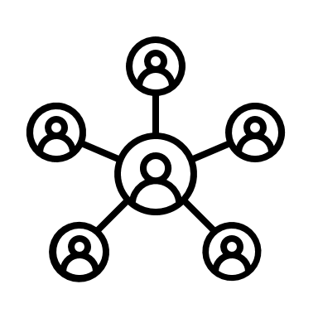

What Is Organizational Culture?
Organizational culture: Shared values, principles, and practices that guide the actions and behavior of an organization‘s members.
“The way we do things in this organization.“
Ethical culture:
Organizational purpose.
Rewards for ethical behavior.
Degree of sensitivity to ethical issues.
Capacity to engage in ethical deliberations.
Accountability practices.
“The way we approach questions about 'what's the right thing to do?' in this organization."

Slide 4




Why Should We Care About Organizational Culture?
Culture
Crisis Response
Adaptability to Change
Technological Progress
Social Progress
"Can we build this product?"
"Should we build this product?"
versus

Slide 5
Organizational Culture and Ethics in Practice (Slide 1 of 2)
Healthy cultures encourage and support employees to do the right thing.
Other cultures tolerate or even encourage misconduct, citing profit, cost containment or other actions as being most important.
Cases:
BP: Numerous crises (explosions, accidents, and oil spills) due to focus on profit.
Boeing: Airline crashes resulting from focus on efficiency and cost-cutting.

Slide 6
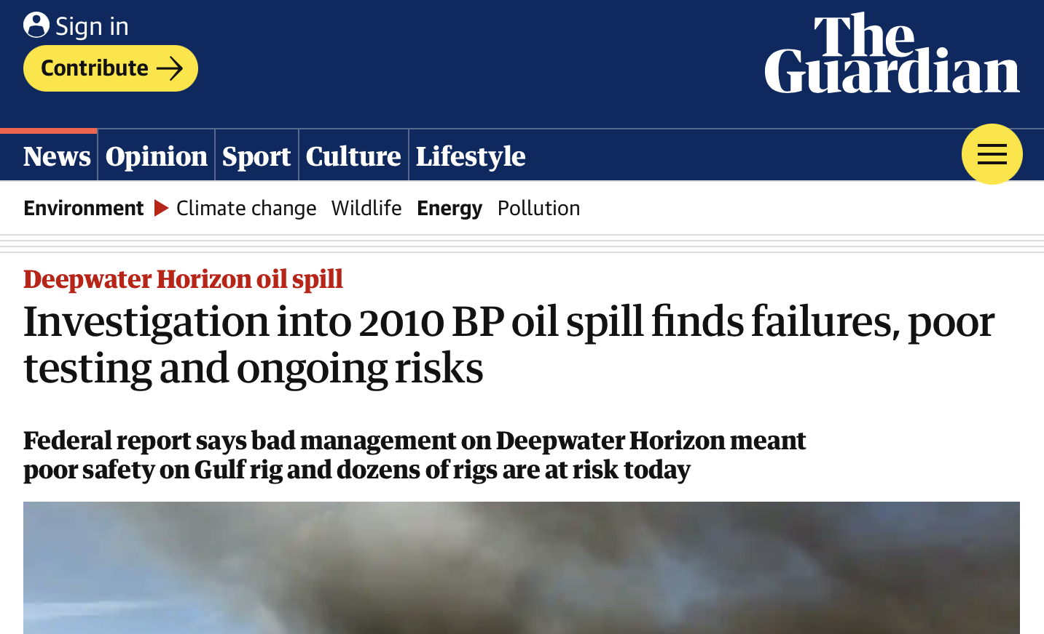
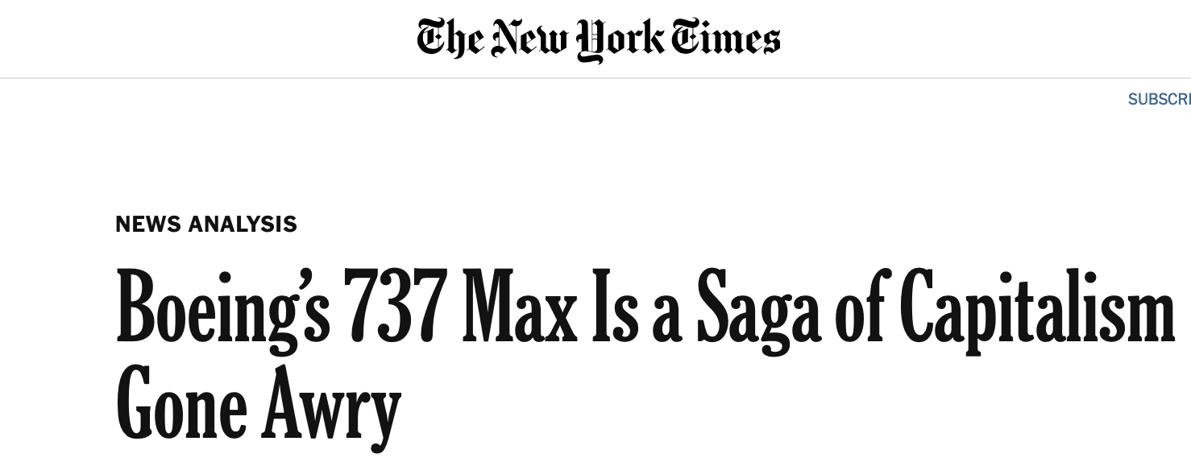
Organizational Culture and Ethics in Practice (Slide 2 of 2)

Slide 7
Activity: Discussing Ethical Organizations
Scenario: General discussion.
Can you think of examples of company culture influencing employee behavior in a positive manner?
Can you think of examples of company culture influencing employee behavior in a negative manner?

Slide 8
Organizational Purpose
Topic B

Slide 9

The Core Questions
Purpose: Why do we exist?
Values: How do we behave?
Ethical action: What do we do?
There is often skepticism about purpose and values:
Lack of awareness and ownership in organizations.
Purpose and value are only the tip of the iceberg: need organizational uptake.

Slide 10

What Is Organizational Purpose?
Why do we exist?
Accept that organizations exist to make people’s lives better.
Generate ownership of a purpose.
Consider purpose from different perspectives: consumer, employees, industry, communities, greater cause.

Slide 11

Organizational Values
Organizational purpose:
Broad brush strokes that need to be distilled into day-to-day reality.
Given our purpose, how do we behave?
Organizational values:
Narrower focus.
Capture the uniqueness of the organization.
Approach values critically.
How should we behave?
How could this behavior have negative impacts?

Slide 12
How Values Fit the Organization
Values need to fit an organization.
They help the organization navigate toward its purpose without causing harm.
They ensure that the work done by an organization is aligned with values our societies embrace.
There is a growing trend in industries to make business-to-business interactions dependent on having shared ethical values.
Values are context-dependent (e.g., technology, product).
Organizations must understand their contexts before formulating organizational values.

Slide 13




Guidelines for Developing Organizational Values
Collect and analyze organizational values from existing authoritative sources.
Draft organizational value statements.
Discuss proposed organizational values with internal and external stakeholders.
Publish organizational values and raise awareness.

Slide 14
Making Values Count (Slide 1 of 2)
VCIO model: (values, criteria, indicators, observable behaviors) A way for organizations to ensure their values translate into observable actions.
Move from purpose and values to measurable action.
Process:
Determine organizational values.
Translate each value into criteria.
Link criteria to indicators.
Link indicators to observable behaviors.

Slide 15
Making Values Count (Slide 2 of 2)
Values
Criterion
Criterion
Criterion
Indicator
Indicator
Indicator
Indicator
Indicator
Indicator
Observable
Observable
Observable
Observable
Observable
Observable

Slide 16
Purpose and Value Statements and Their Impact
Organizational purpose and values are important, but they are often met with skepticism.
Organizations must “walk the talk.”
It’s not enough to say it values sustainability and well-being—an organization must also act on those values.
Sometimes, leadership and employees are only vaguely aware of the organizational purpose and value statements and have had little say in how these were formulated.
This generates a lack of ownership and effect.
Consider a purpose and values statement as only the tip of the iceberg.
The expression of what an organization truly stands for and works towards.
What is hidden is how organizational principles and values affect the day-to-day work of the leadership and employees.
This is where ethics starts to count.

Slide 17
Activity: Discussing Organizational Purpose (Slide 1 of 2)
Scenario: General discussion. Here are some organizational purpose statements to consider:
To enrich people’s lives with programs and services that inform, educate, and entertain.
To make it easy to do business anywhere.
Our deepest purpose as an organization is helping support the health, well-being, and healing of both people—customers, Team Members, and business organizations in general—and the planet.
Which of these statements of organizational purpose do you think most reflects an ethical organizational culture?
Why did you select that answer?
Which of these statements of organizational purpose do you think least reflects an ethical organizational culture?
Why did you select that answer?

Slide 18
Activity: Discussing Organizational Purpose (Slide 2 of 2)
(Optional) With what you know about the RudiBrace product, draft organizational purpose and value statements for Rudison Technologies.
(Optional) Open a new browser tab or window, and search for organizational purpose and value statements that you think promote and support an ethical organization. If your instructor requests, you can share your findings with the other participants.

Slide 19
Ethics Awareness
Topic C

Slide 20
Why Awareness Matters
Type of Business Impact | Example
Negative social impacts | How your organization affects societal issues like inequality, fairness, or political polarization.
Loss of organizational reputation | How a decision to ban messages by certain politicians on your social media platform impacts your organization’s reputation.
Loss of consumer trust | How introducing algorithmic decision-making for loan approval impacts trust by customers in your company.
Liability | When acquiring a company, your organization may become liable for harms caused by the acquired company, even if you knew nothing about those impacts.
Legal/regulatory obligations | By processing personal data, you become liable to strict privacy laws like GDPR, causing significant compliance costs.

Slide 21
Drivers of Awareness
Clarity of Purpose and Expectations
Communicate the purpose of the organization and the expectations of employees clearly and regularly.
Diversity of Thought
Hire people that bring different perspectives and staff teams to create diversity of thought.
Organizational Memory
Learn from mistakes and spread that knowledge throughout the organization.
Speak Up!
Encourage employees to share knowledge and challenge superiors.

Slide 22
Clarity of Purpose and Expectations
Principles
Share how the organization is already making good on its purpose, and where it is still falling short.
Reinforce the ethical expectations of the organization towards every employee.
Make commitments count.
Examples
Leadership communication: Share stories of brave decisions that reinforce the organization’s purpose and expectations.
Iconic actions: Identify highly visible actions or policies that encapsulate your organization’s purpose and the expectations for its people.
Ethics moments: Invite members of the organization to raise difficult decisions they faced or currently face in a safe and open forum in the organization.

Slide 23
Diversity of Thought
Principles
The more diverse the teams working on new technology, the more likely it is that someone will spot an ethical risk.
Diversity and inclusion efforts are crucial but not sufficient to achieve diversity of thought.
Teams whose members have different cognitive styles and encourage open-mindedness are more likely to display diversity of thought.
Examples
DEI efforts: Develop a Diversity and Inclusion policy.
Encourage open-mindedness and intellectual humility: Insist on every employee displaying respect for other viewpoints.
Engage stakeholders and outside experts: Invite outside experts or stakeholder representatives to an open discussion.
Use ethical foresight tools: Conduct a scenario analysis as part of your regular planning process.

Slide 24
Organizational Memory
Principles
The ability of organizations to record, share, and act on learnings from the past.
Organizations can learn from mistakes by reflecting on the root causes of ethical incidents.
Ethical foresight is a way of thinking about and planning for ethical risk and opportunity in everyday practice.
Examples
Establish a Review Board: Establish an external ethics review board and/or an internal ethics function.
Investigate ethical failures to identify individual as well as structural root causes.
Share Learnings: Share learnings with employees and embed learnings in ethics training.
Document Learnings: Document ethics review and decision-making processes.

Slide 25
Speak Up!
Principles
Create an open culture where people can raise serious concerns and be heard.
To be credible, leaders must react to criticism in an open and welcoming way.
Encouraging speak-up can get organizations only so far.
Examples
Foster a culture of trust and candor: Employees must trust and respect one another and organizational leadership for candid feedback to flow freely.
Create safe and confidential reporting channels: An ethics hotline allows employees to speak up anonymously. Ethics hotlines should be operated by a trusted third-party vendor.

Slide 26
Activity: Identifying Drivers of Awareness
Scenario: Consider the RudiBrace product, or a product from your workplace.
List two or three ethical risks and/or business impacts that you want to drive awareness of.
Select two drivers of ethical awareness and explain how they can help improve awareness.

Slide 27
Develop Professional Ethics within Organizations
Topic D

Slide 28

People's Qualities and Organizational Culture
Ethical organizations depend on qualities of their people: collegiality, prudence, etc.
Unethical organizations cultivate bad qualities: dishonesty, secrecy, etc.
How to stimulate good qualities?
Community building
Professional skills development
Training and education
Team management

Slide 29

Ethics in Traditional Professions
Ethical oaths in finance and medicine:
In Ancient Greece: Hippocratic oath for physicians:
Professional, ethical commitments
E.g., medical confidentiality, non-maleficence
Also in the tech sector: a good engineer also considers positive and negative impacts on society.

Slide 30

Community Building
Balancing diversity and shared commitments
Facilitate community building:
Reimagine role of leadership.
Create space for organization-wide deliberation.
Frame conversation around bigger picture issues.
Frame conversation around issues that trigger diversity of opinions.

Slide 31

Professional Skills Development
Ethics requires skills in communication and critical thinking.
How to align professional skills with ethical skills:
Ethical oath: Listing core values of organizational members in an imperative form.
Training: Knowledge-intensive and practical.
Organizational resourcing: Align professional roles with ethics activities.

Slide 32



Training and Education
Ethics education helps in raising ability to perceive and address ethical issues.
How to organize an ethics training and education program?
Model around practical cases.
Use materials from organizations specialized in professional education.
Make use of practical tools.
Customize program for organizational roles.

Slide 33

Team Management
Cultivating people’s qualities in day-to-day work.
Organize a team in an ethical manner:
Link tasks and practices to people’s ethical beliefs and aspirations.
Allow for participatory decision-making.
Channel ethical concerns into procedures.
Give people opportunities to ethically excel.

Slide 34
Activity: Discussing Professional Ethics
Scenario: Consider the RudiBrace product, or a product from your workplace. RudiBrace team members will declare an ethical oath. Remember, primary concerns are related to privacy and fairness.
With this information in mind, can you suggest two statements for the RudiBrace ethical oath?

Slide 35
At your workplace, is there a culture or value statement in place? How does it align with the information discussed in this lesson?
At your workplace, what suggestions might you make to foster an environment that values professional ethics?

